Slide 1
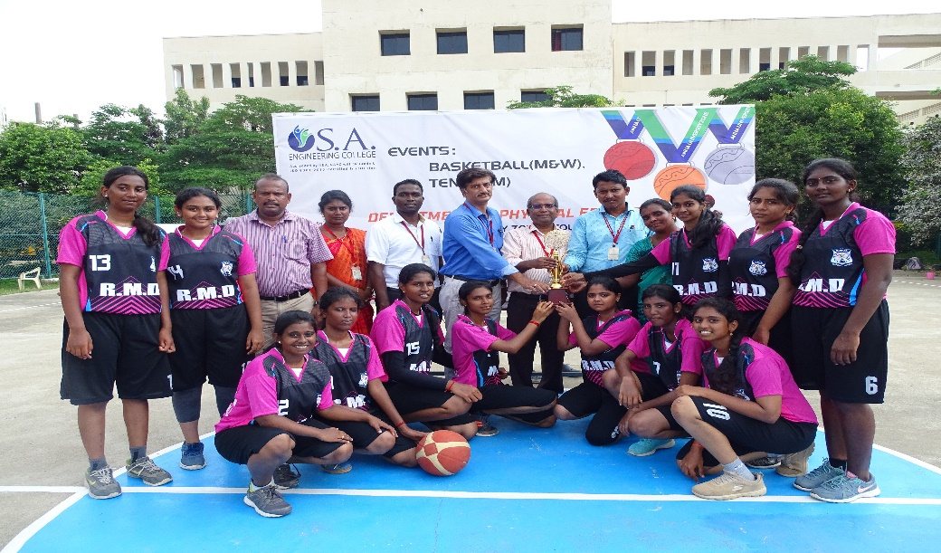
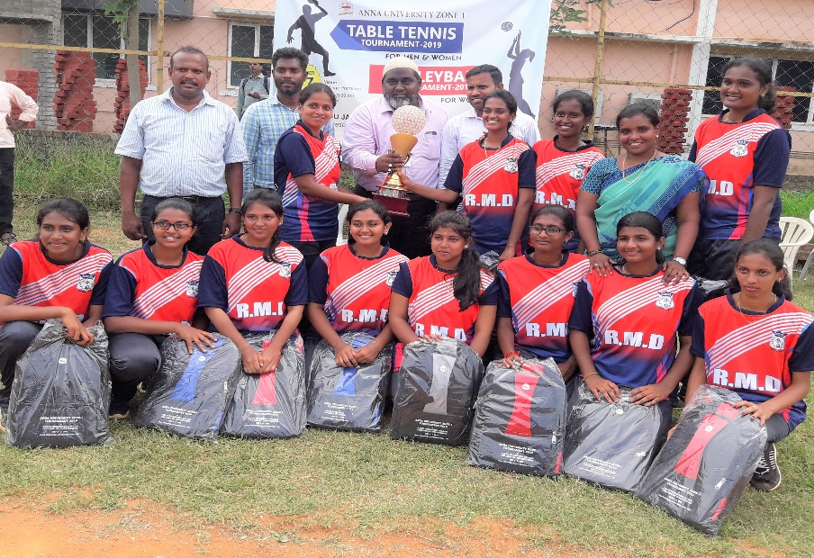
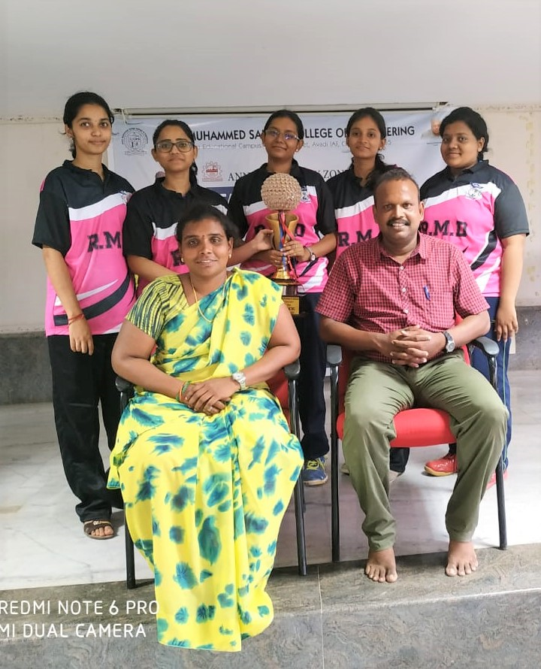
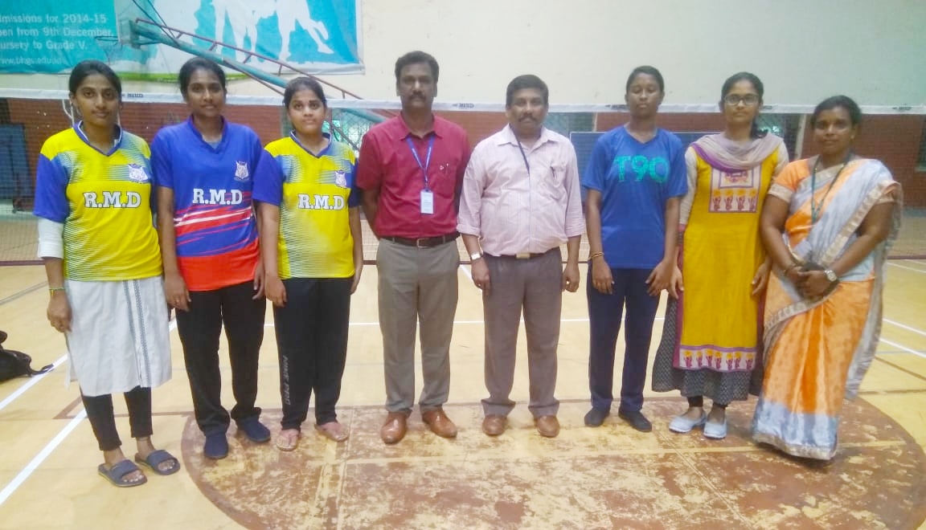
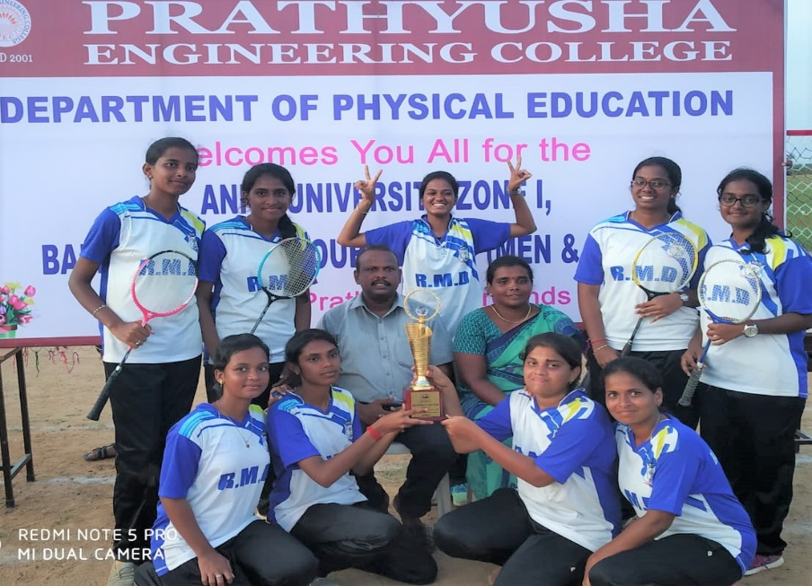
ACHIEVEMENTS OF WOMEN’S TEAM 2019 -2020
BASKETBALL-WINNER
VOLLEYBALL –WINNER
TABLE TENNIS–WINNER
BADMINTON – THIRDPLACE
BALLBADMINTON - WINNER

Slide 2
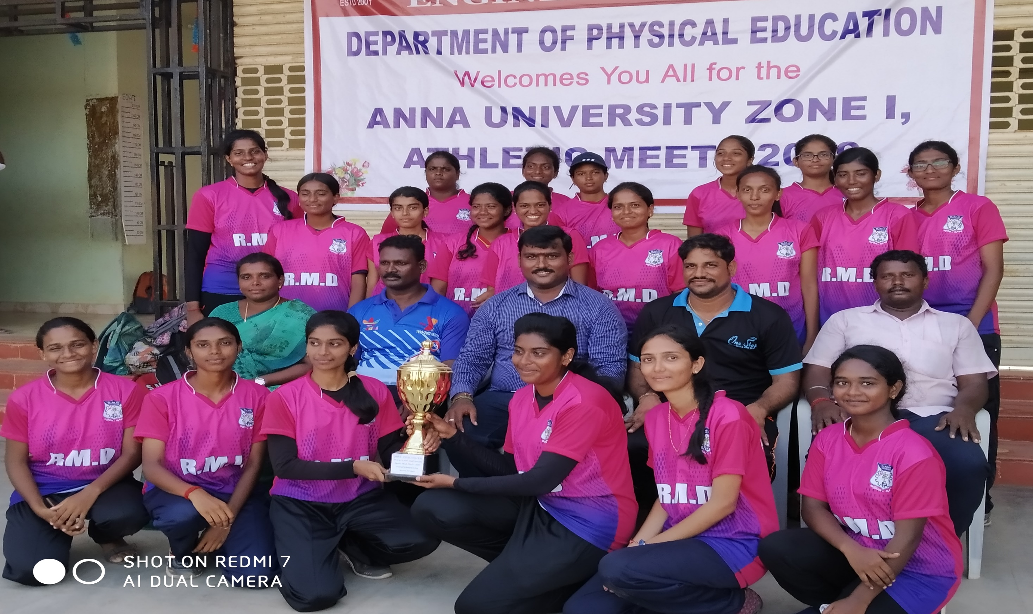
ANNA UNIVERSITY ZONE-1WOMEN’S ATHLETICS MEET OVERALL CHAMPIONS
WINNER 2019-2020

Slide 3
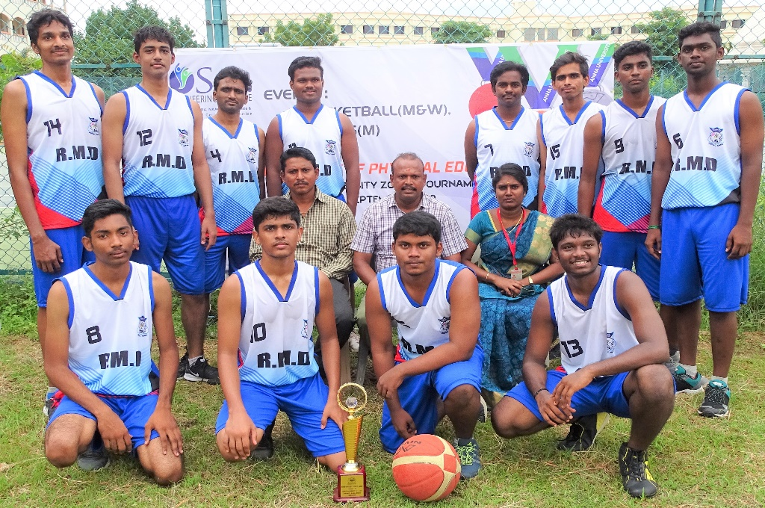
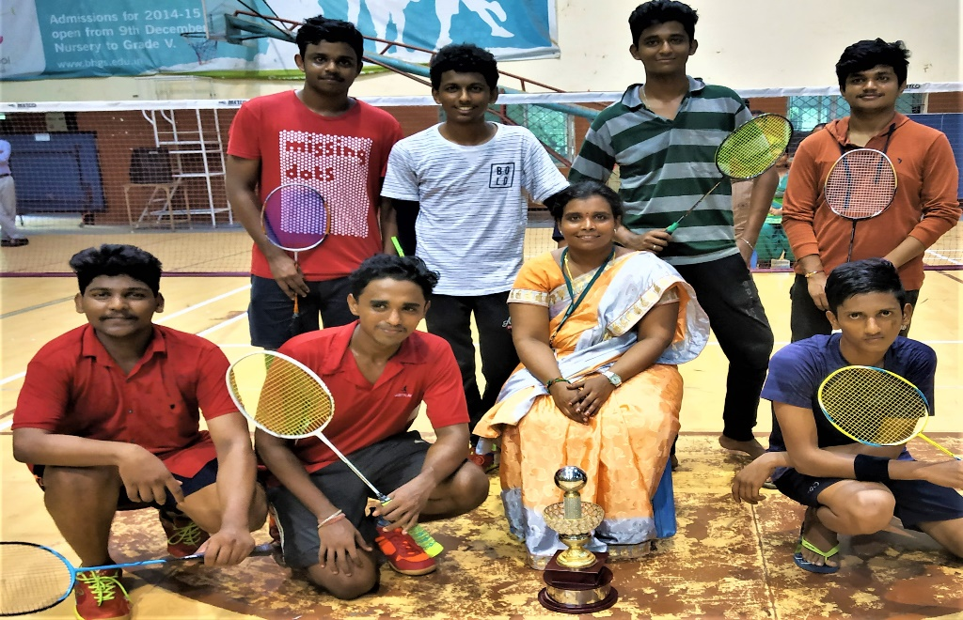
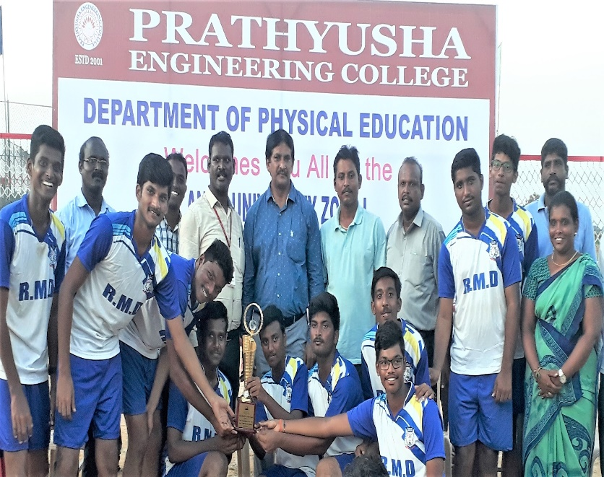
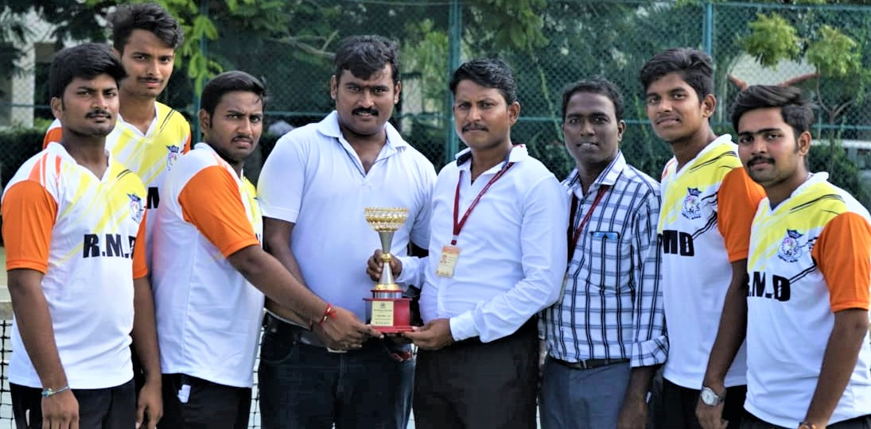
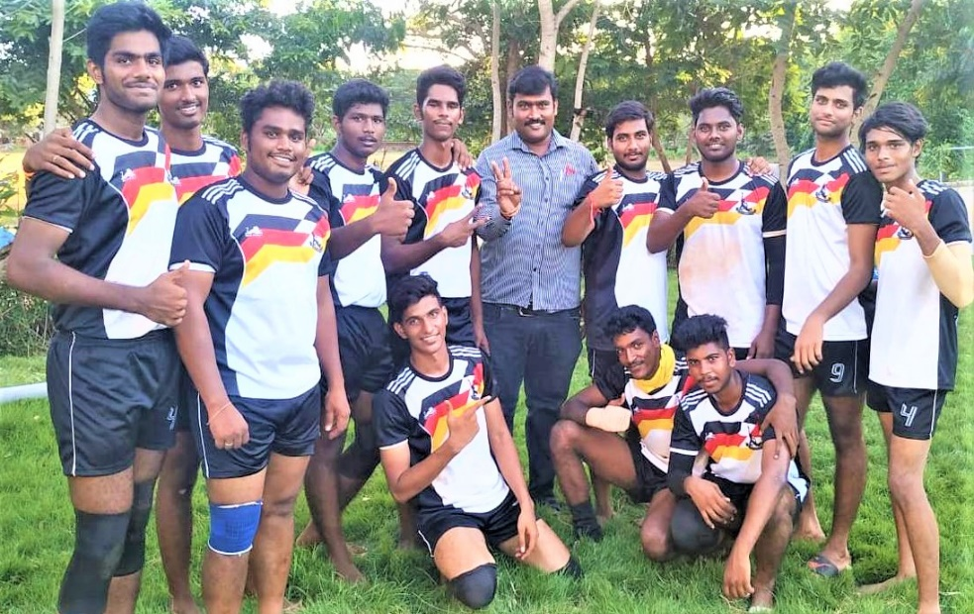
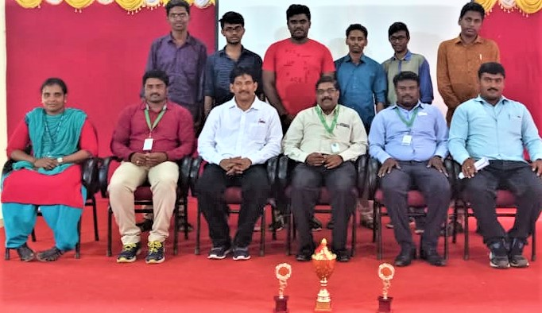
ACHIEVEMENTS OF MEN’S TEAM 2019 -2020
BASKETBALL-3rd PLACE
BADMINTON-3RD PLACE
BALLBADMINTON – RUNNER UP
TENNIS-3RD PLACE
KABADDI-4TH PLACE
CHESS-RUNNER UP

Slide 4
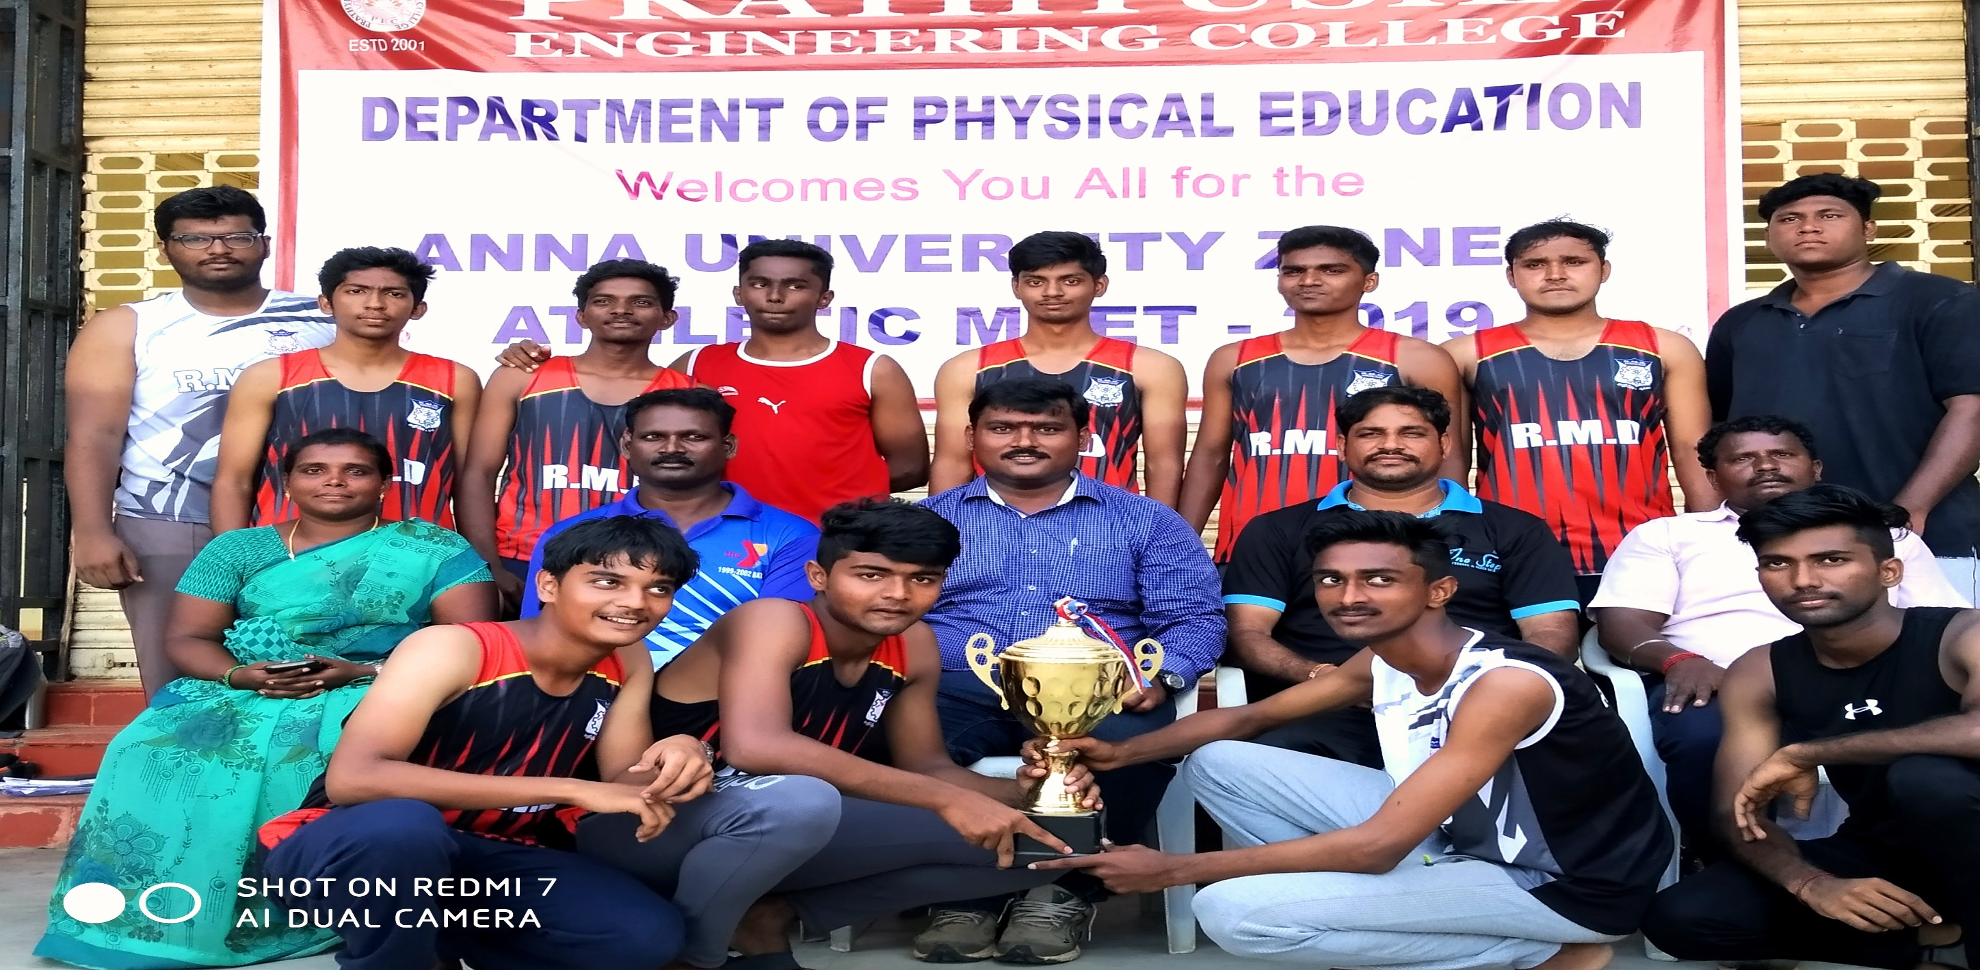
ANNA UNIVERSITY ZONE-1 ATHLETICS OVERALL CHAMPIONS 2019-2020
MEN’S -RUNNER UP

Slide 5
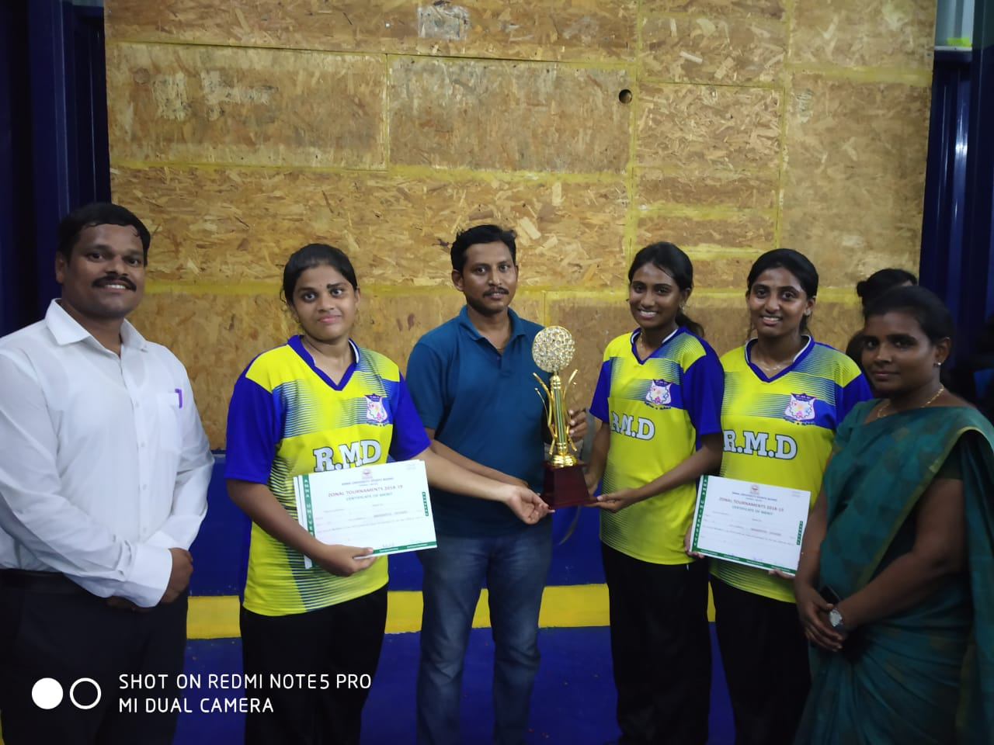
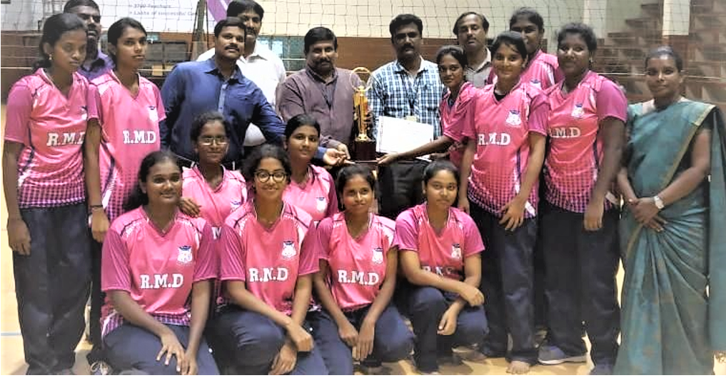
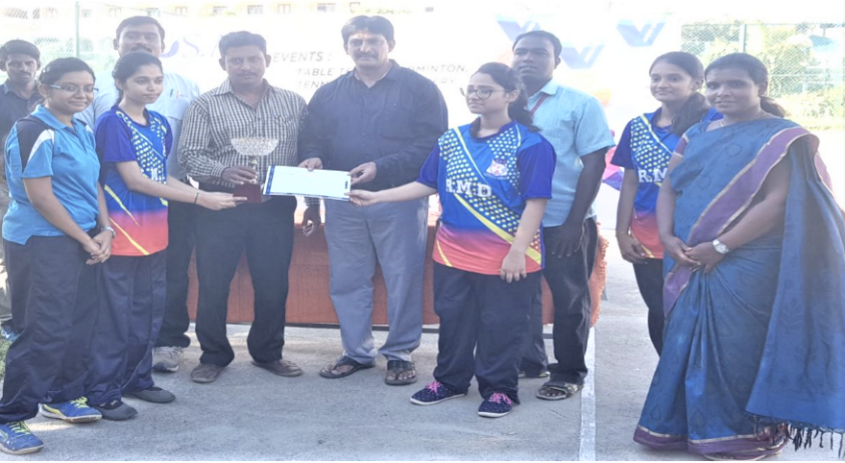
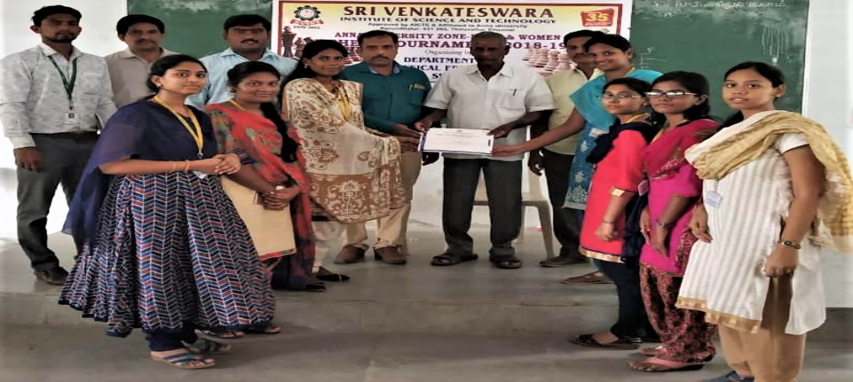
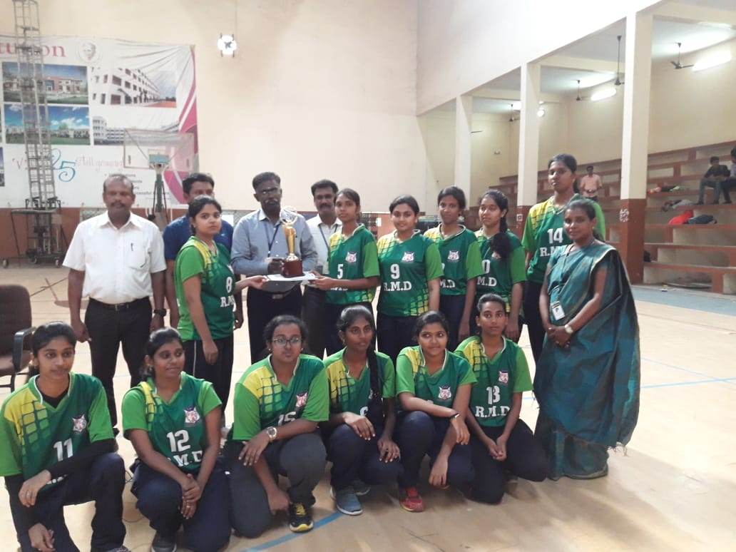
ACHIEVEMENTS IN THE SPORTS AND GAMES – 2018 -2019
VOLLEYBALL – WINNER
BADMINTON – RUNNER UP
TABLE TENNIS-THIRD PLACE
CHESS– THIRD PLACE
BASKETBALL – RUNNER UP

Slide 6
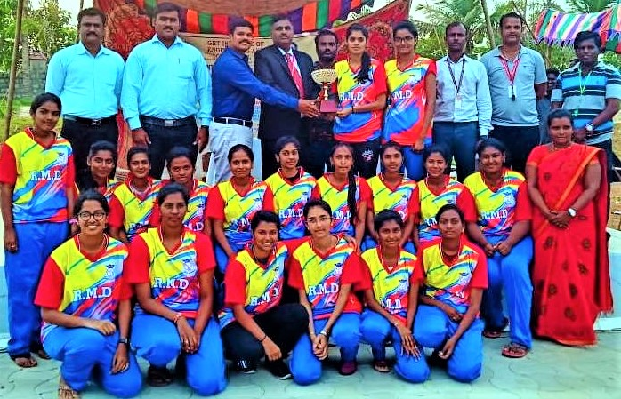
ANNA UNIVERSITY ZONE-1ATHLETICS OVERALL CHAMPIONS 2018-2019 WOMEN’S -WINNER

Slide 7
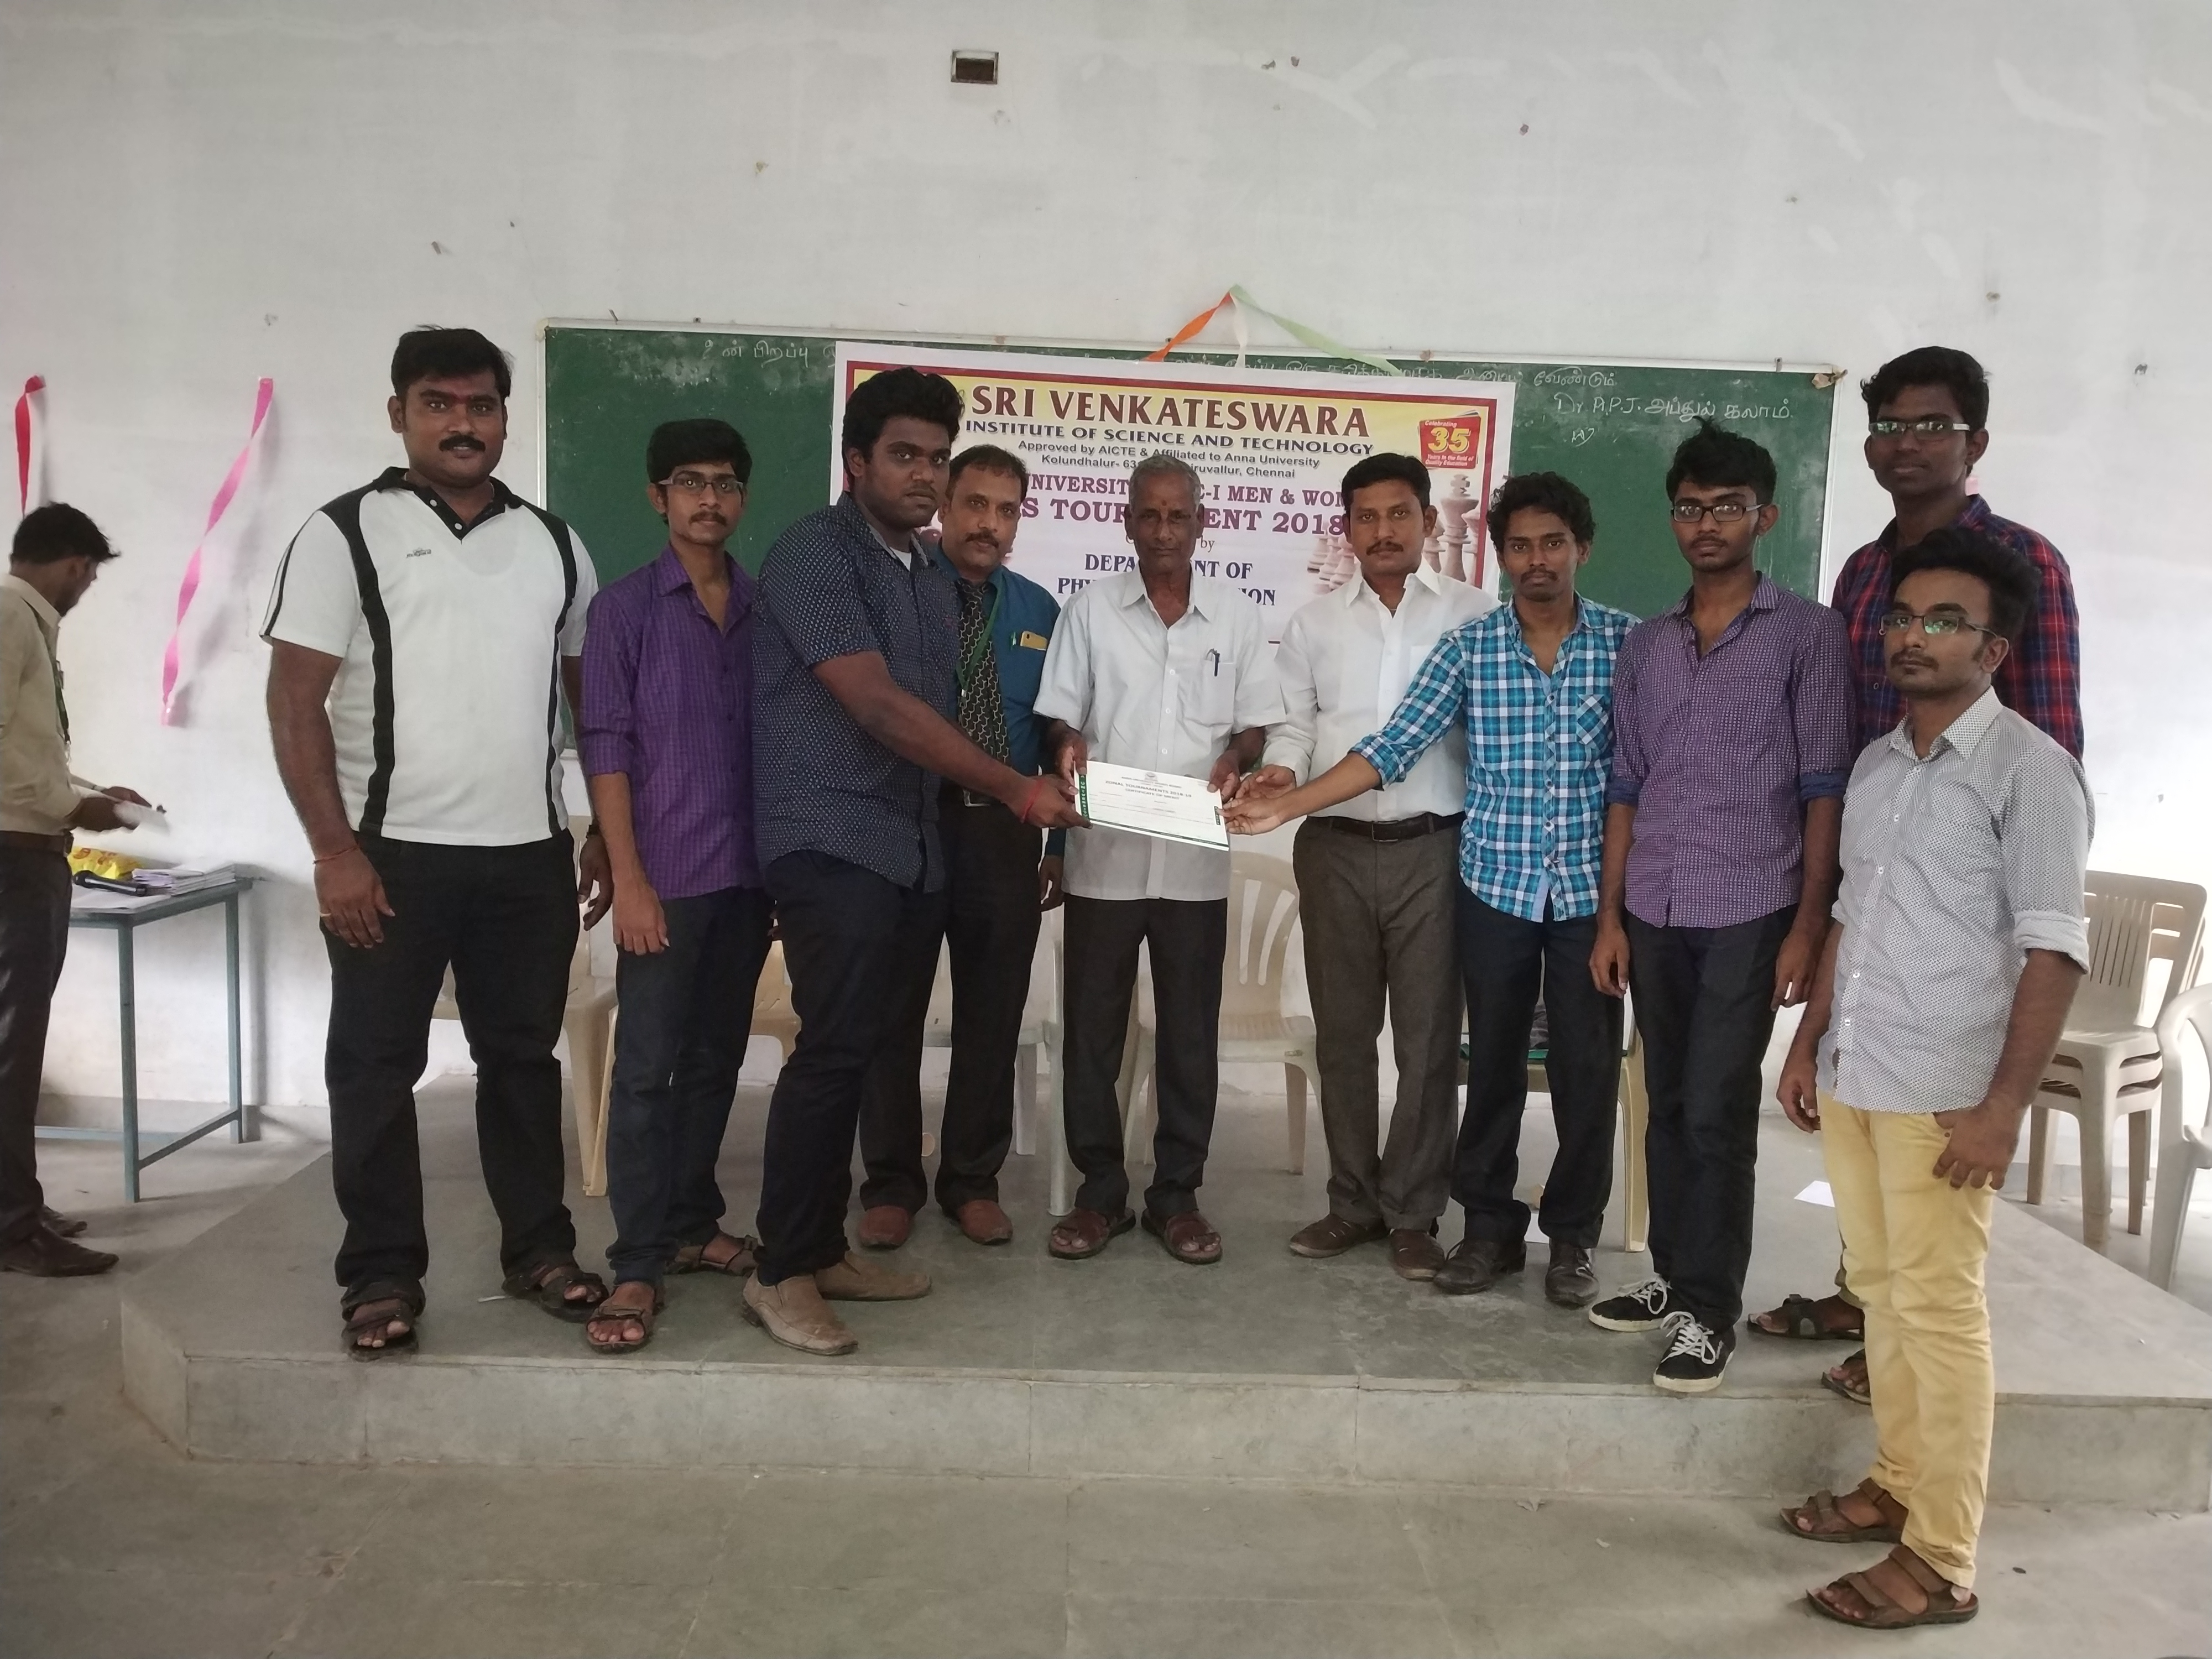
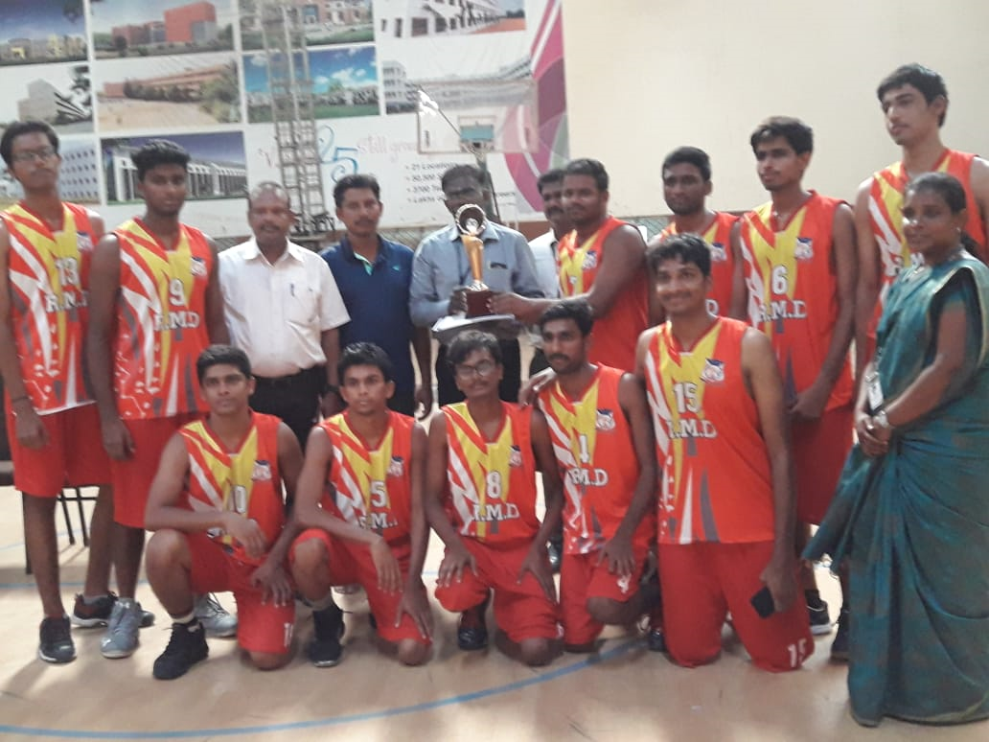
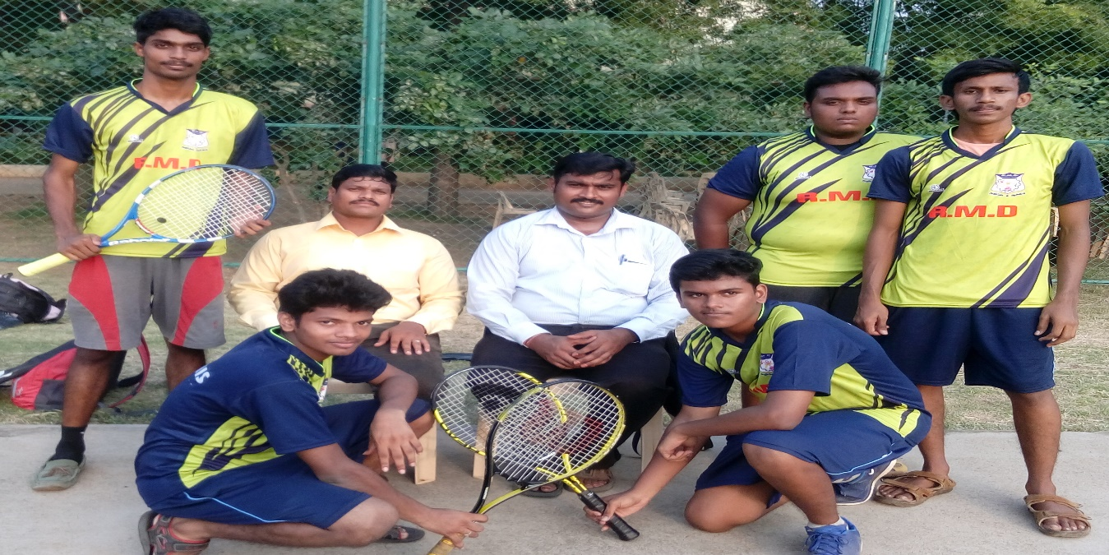
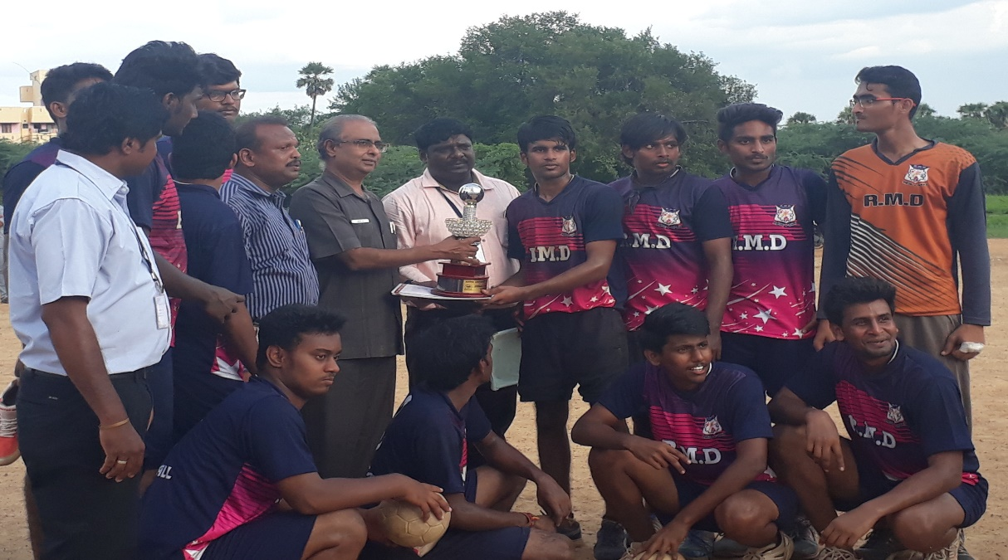
ACHIEVEMENTS IN THE SPORTS AND GAMES – 2018 -2019
CHESS –RUNNVER UP
BASKETBALL –3RD POSITION
TENNIS –THIRD PLACE
HANDBALL –THIRD PLACE

Slide 8
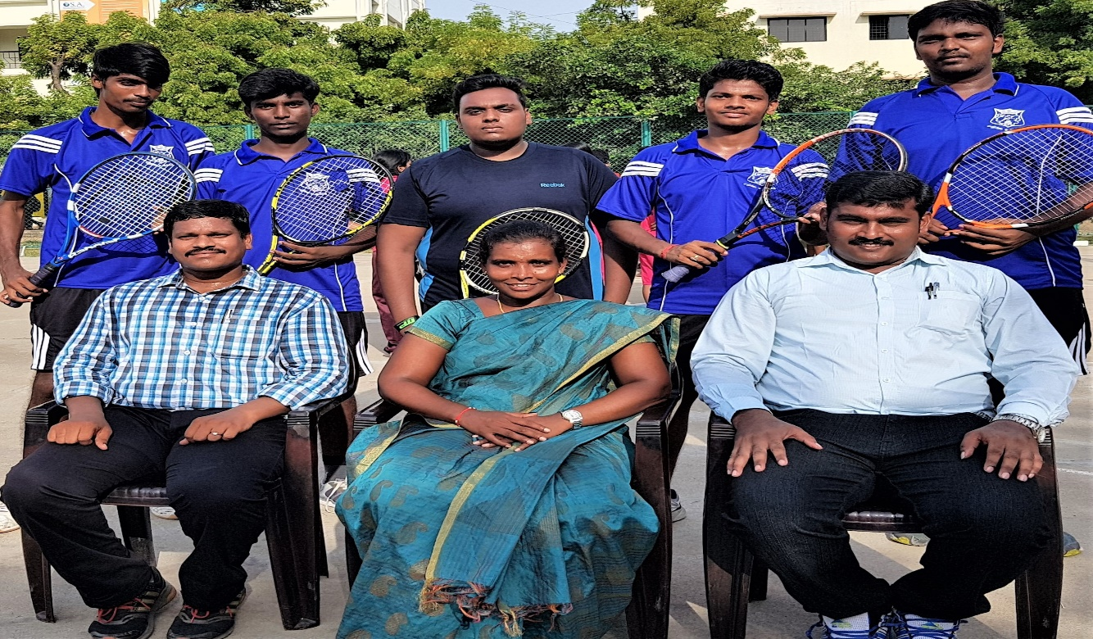
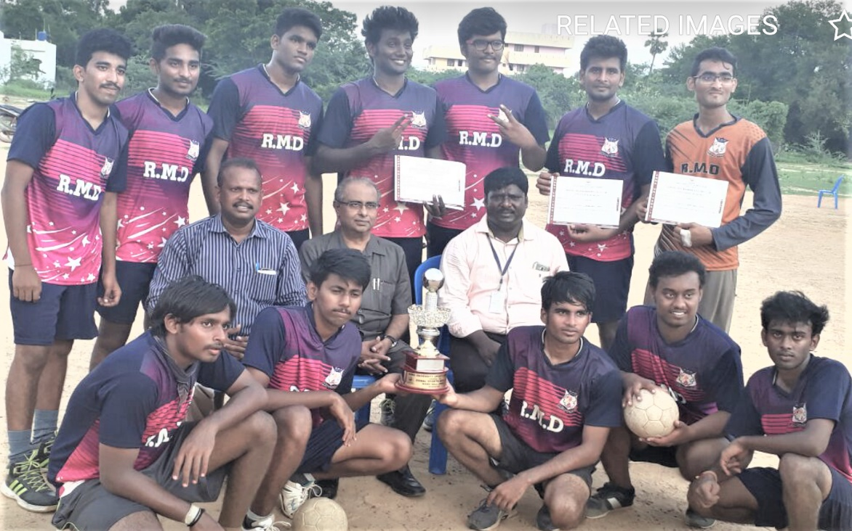
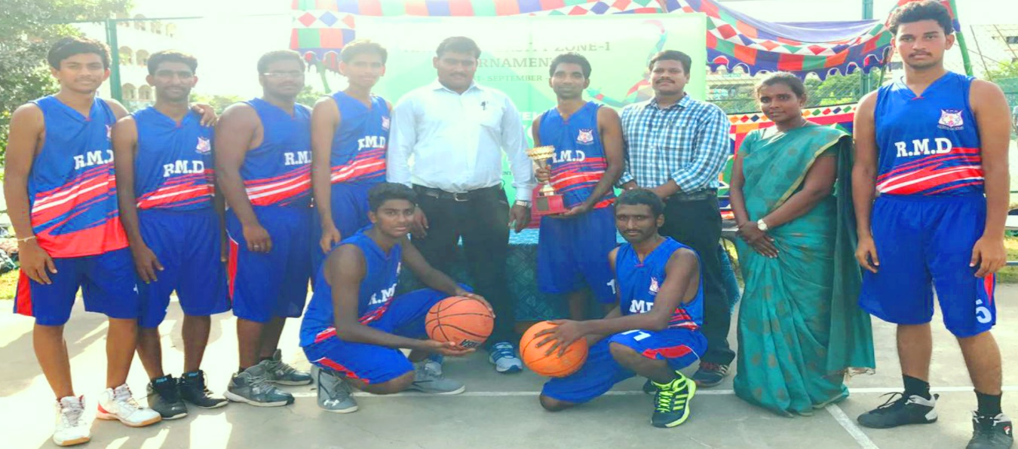
ACHIEVEMENTS IN THE SPORTS AND GAMES – 2017 -2018
TENNIS – THIRD PLACE
HANDBALL – WINNER
BASKETBALL –FOURTH POSITION

Slide 9
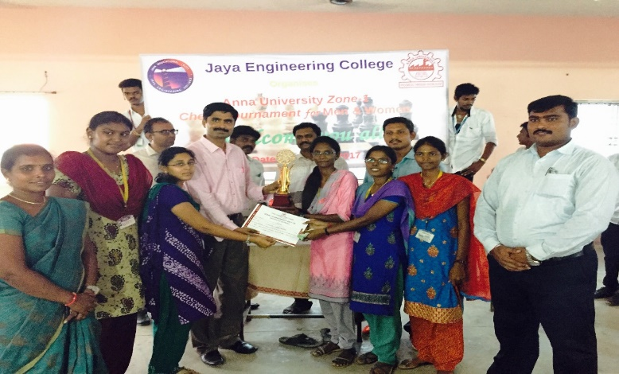
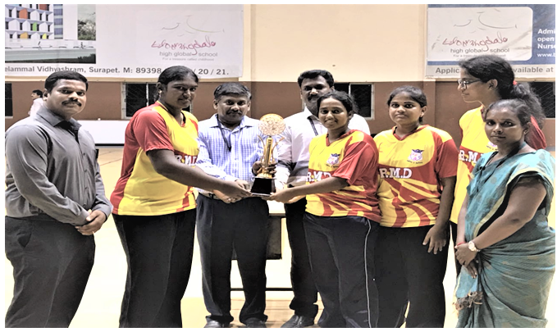
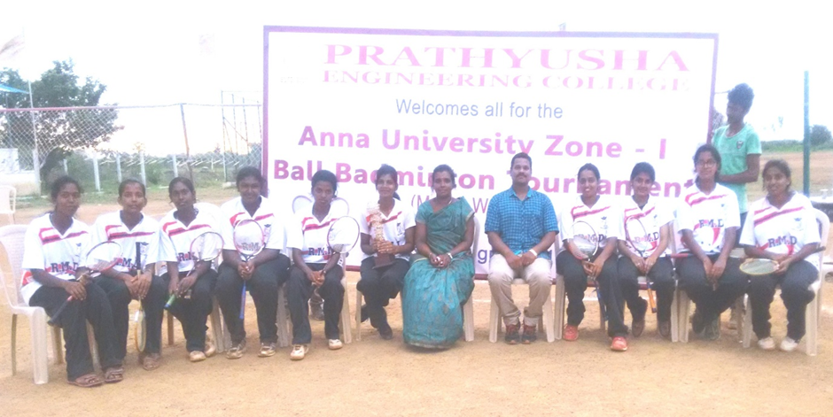
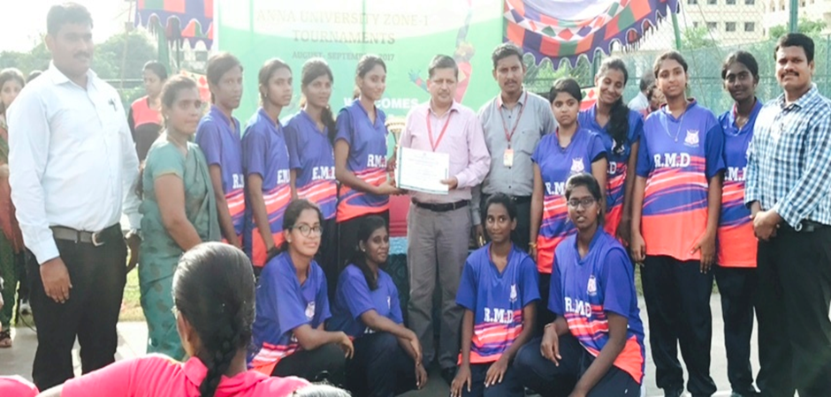
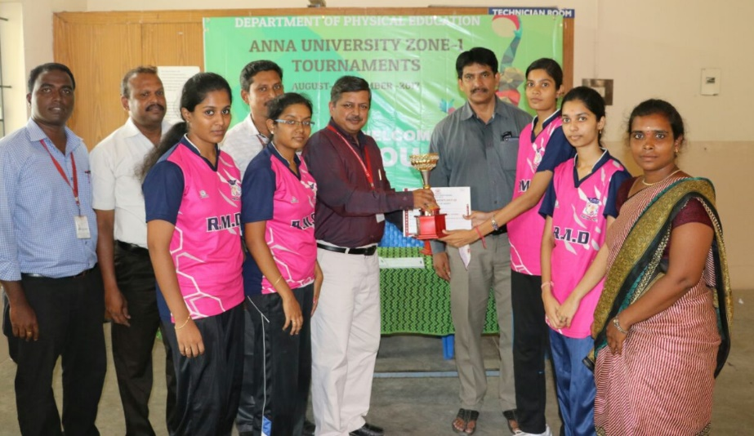
ACHIEVEMENTS IN THE SPORTS AND GAMES – 2017 -2018
CHESS –WINNER
BADMINTON – WINNER
BALL BADMINTON –RUNNER-UP
BASKETBALL – RUNNER-UP
TABLE TENNIES- 3RD PLACE

Slide 10
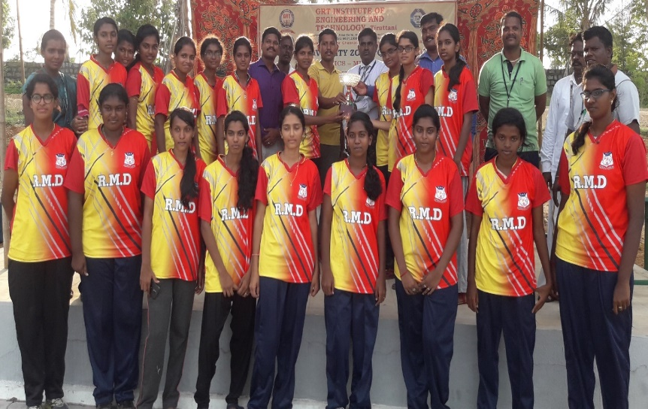
ANNA UNIVERSITY ZONE-1WOMEN’S ATHLETICS MEET OVERALL CHAMPIONS
WINNER 2017-2018

Slide 11
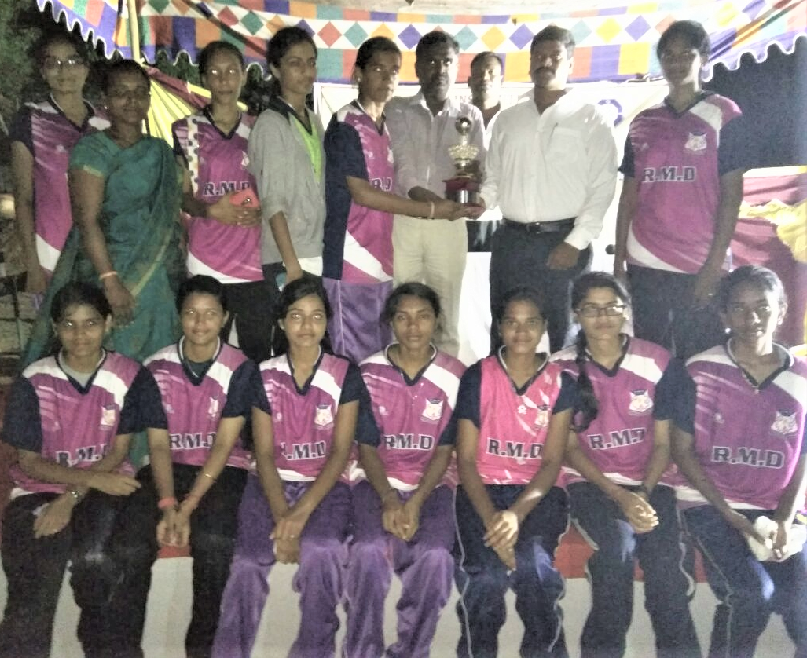
ANNA UNIVERSITY ZONE-1 ATHLETICS OVERALL CHAMPIONS 2016-2017
WOMEN’S – RUNNER UP

Slide 12
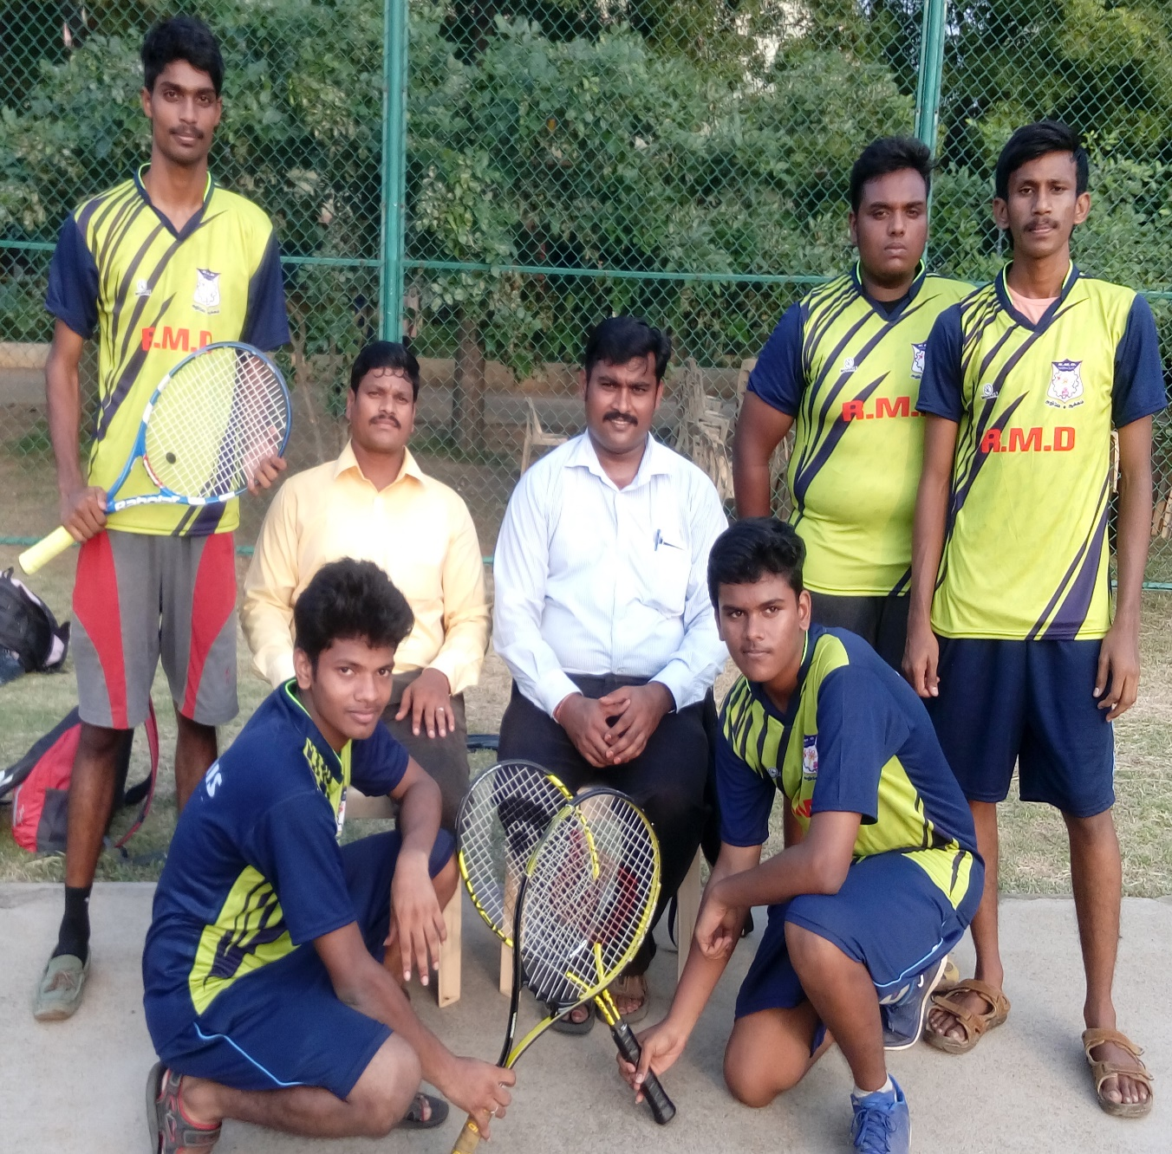
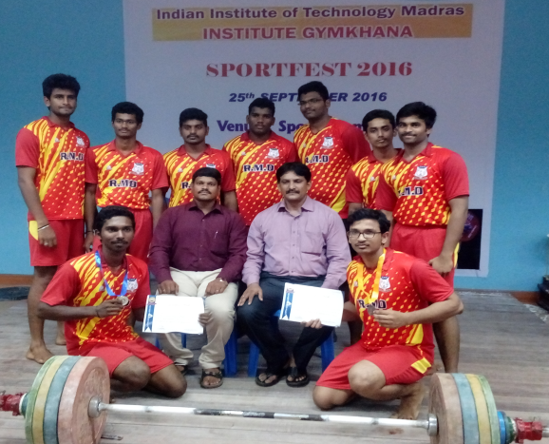
ACHIEVEMENTS IN THE SPORTS AND GAMES – 2016 -2017
TENNIS- 3RD POSITION
STATE LEVEL IIT COMPETITION
WEIGHT LIFTING MEN TEAM OVERALL 3RD POSITION

Slide 13
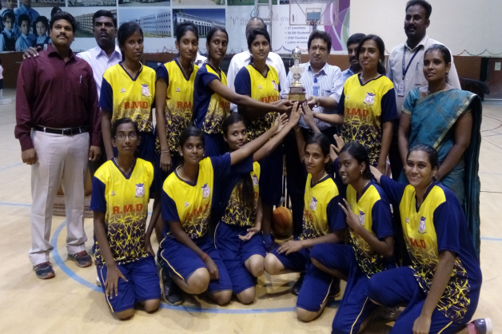
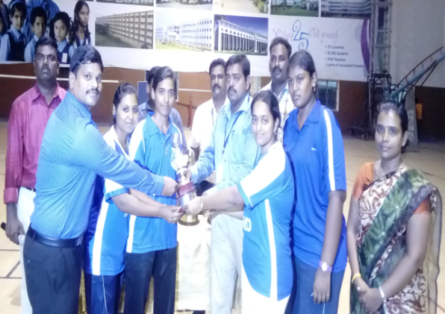
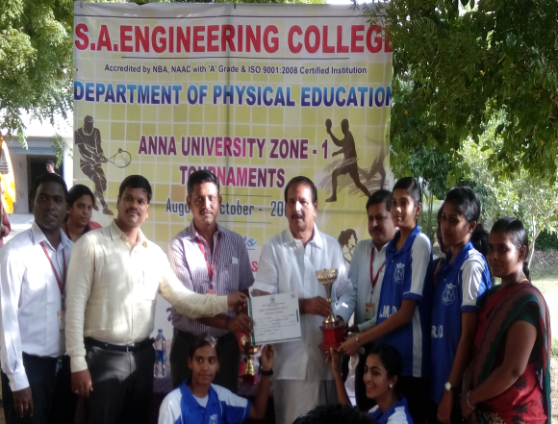
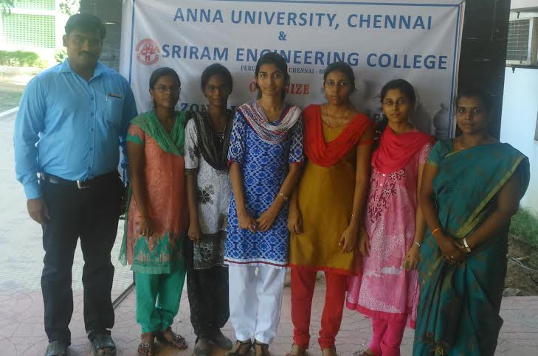
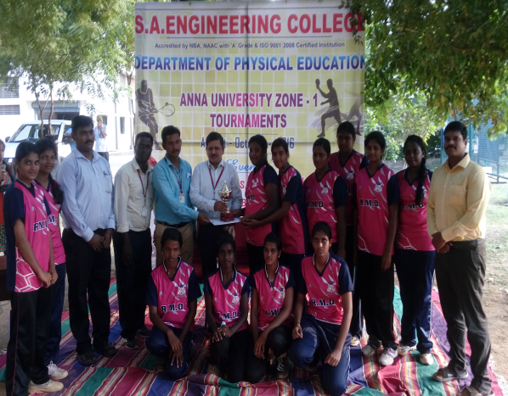
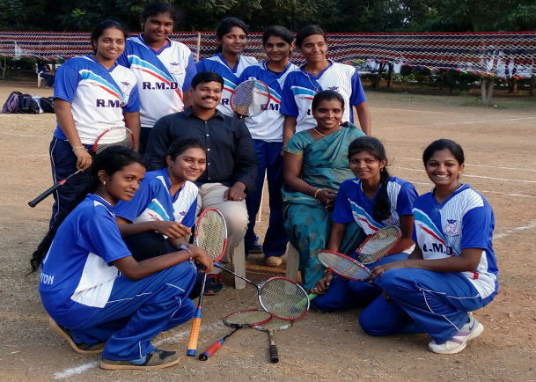
ACHIEVEMENTS IN THE SPORTS AND GAMES – 2016 -2017
BASKETBALL -RUNNER-UP
BADMINTON - RUNNER-UP
TABLE TENNIS -RUNNER-UP
CHESS– WINNER
VOLLEY BALL -3RD POSITION
BALL BADMINTON -RUNNER-UP

Slide 14
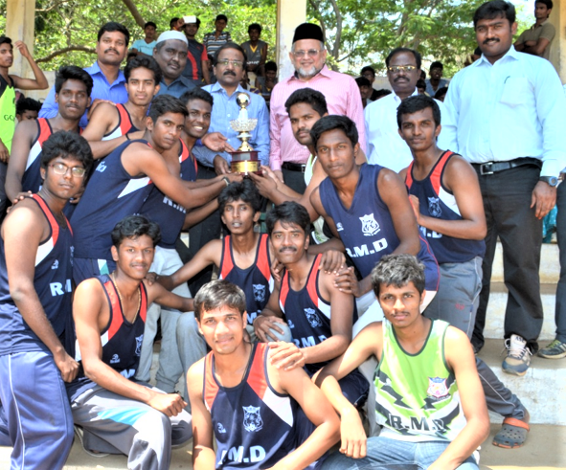
ANNA UNIVERSITY ZONE-1 ATHLETICS OVERALL CHAMPIONS 2015-2016
MEN -WINNER

Slide 15
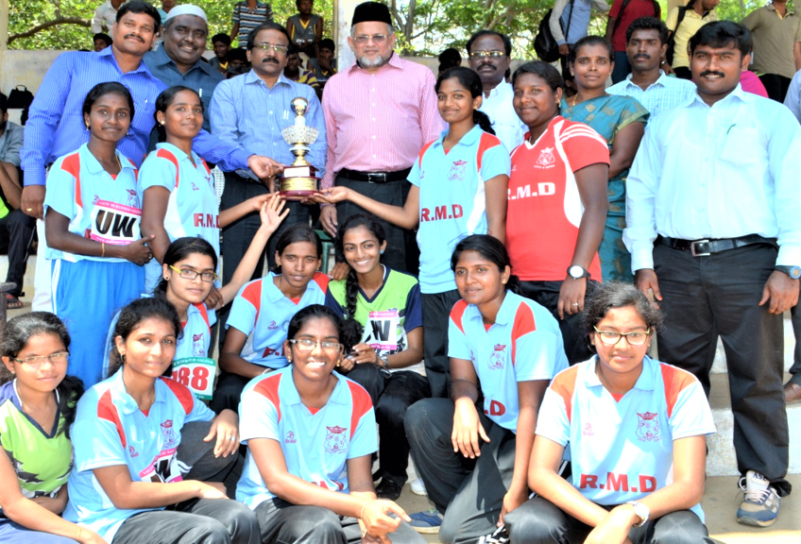
ANNA UNIVERSITY ZONE-1 ATHLETICS OVERALL CHAMPIONS 2015-2016
WOMEN’S -WINNER

Slide 16
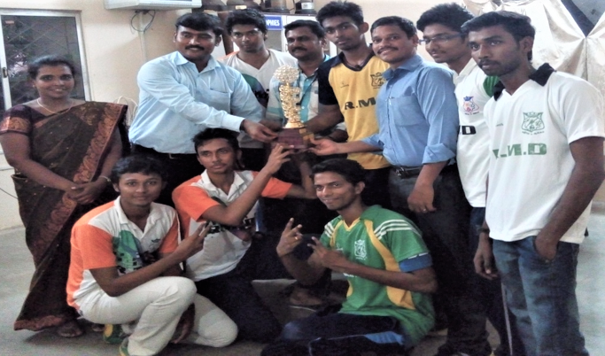
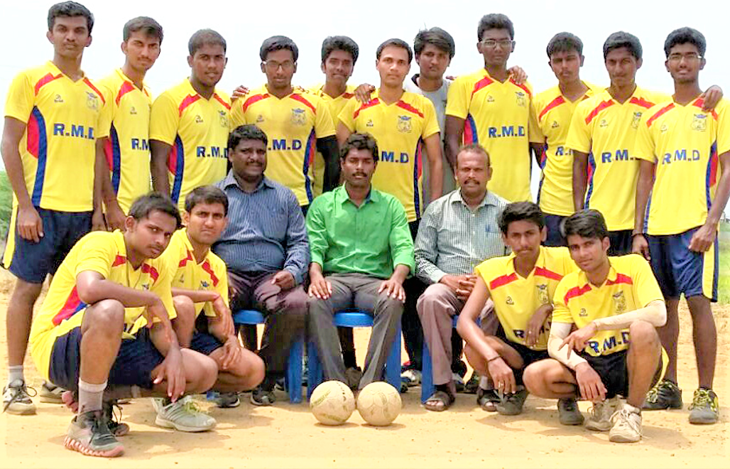
ACHIEVEMENTS IN THE SPORTS AND GAMES – 2015 -2016
BADMINTON –WINNER
HANBALL - FOURTH PLACE

Slide 17
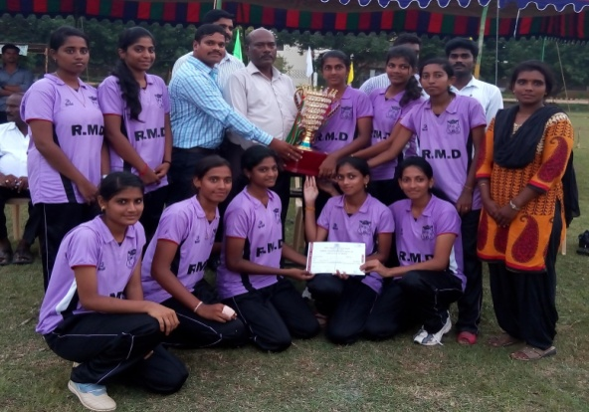
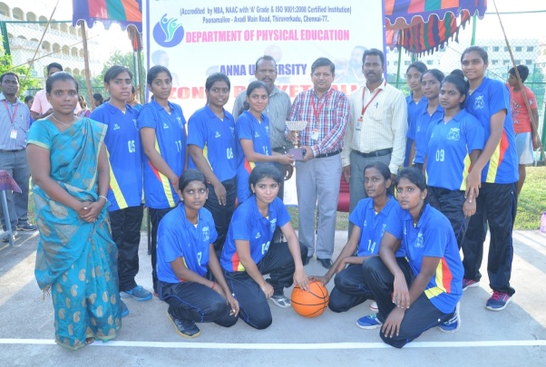
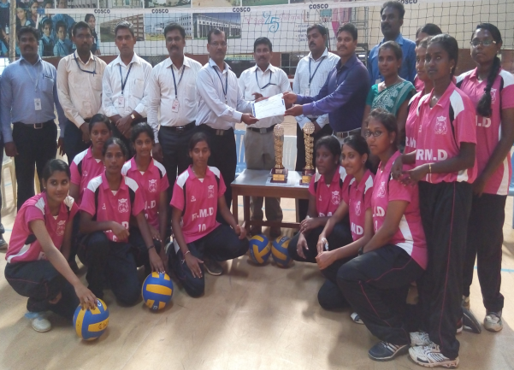
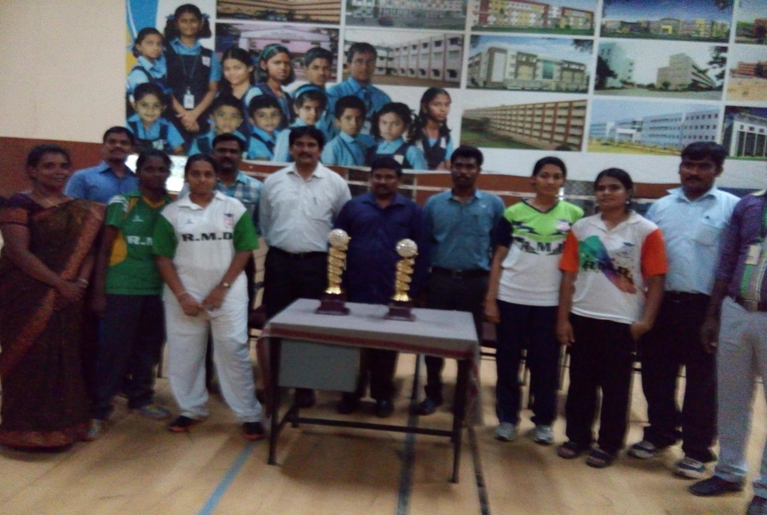
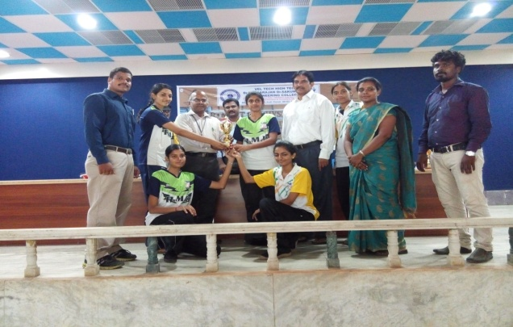
ACHIEVEMENTS IN THE SPORTS AND GAMES – 2015 -2016
BALLBADMINTON –WINNER
BASKETBALL –RUNNER-UP
VOLLEYBALL –3RD POSITION
BADMINTON –RUNNER-UP
TABLE TENNIS –RUNNER-UP

Slide 18



ACHIEVEMENTS IN THE SPORTS AND GAMES – 2014 -2015
BADMINTION –RUNNER UPUP
CRICKET –3RD POSITION
BASKETBALL – 3RD POSITION

Slide 19





ACHIEVEMENTS IN THE SPORTS AND GAMES – 2014 -2015
BASKET BALL – RUNNER-UP
BALLBADMINTION – WINNER
TABLE TENNIS –WINNER
BADMINTION –WINNER
VOLLEY BALL – 3RD POSITION

